Slide 1

Connecting Veterinary Diagnostic Laboratories
Building the AAVLD Interoperability Framework
Thursday, October 15, 2026

Slide 2
AAVLD / INFORMATICS SYMPOSIUM
PURPOSE & OUTCOMES
Purpose & Outcomes
Discuss interoperability initiatives in comparable industries
Explore what interoperability means within the veterinary diagnostic laboratory space
Identify key problems and use cases for veterinary diagnostic interoperability
Discuss information needed to describe electronic services
Identify the minimum information and workflow required to transmit testing information
Determine governance and sustainability needs for interoperability solutions

Slide 3
AAVLD / INFORMATICS SYMPOSIUM
AGENDA & SPEAKERS
Agenda & Speakers
8:00–8:15
Welcome: Why Veterinary Laboratories Need an Interoperability Framework – Doug Holbrook
8:15–8:30
Lessons in Building Interoperability – Dr. Julie Green, DVM, MS
8:30–9:20
Defining Veterinary Diagnostic Laboratory Interoperability – Dr. Michael Dark
9:20–10:00
Framework Component 1: Publishing Laboratory Tests & Services and Electronic Ordering – Emily Hashey
10:00–10:15
Break
10:15–10:55
Framework Component 2: Test Requests, Accessions, and Communication – Tammy Leimer
10:55–11:30
Framework Component 3: Results, Corrections and Status – Sarah Tomlinson
11:30–11:50
Governance, Sustainability, and Community Coordination – Doug Holbrook
11:50–12:00
From Symposium to Framework: Consensus and Next Steps – Doug Holbrook & Dr. Michael Dark

Slide 4
AAVLD / INFORMATICS SYMPOSIUM
FEATURED PRESENTATION
SESSION 01
Welcome: Why Veterinary Laboratories Need an Interoperability Framework
Doug Holbrook

Slide 5
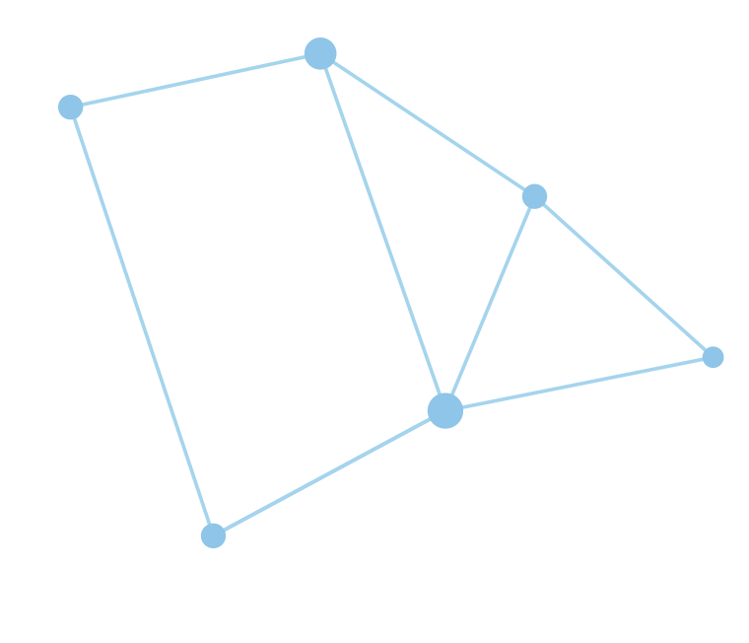






AAVLD / INFORMATICS SYMPOSIUM / WELCOME
One specimen. Three systems. Six emails.
Submitting laboratory
Receiving laboratory
Requesting system
“Is this the same specimen?”
“Accepted — or just received?”
Its own case, specimen, and test names
Different identifiers, validation, and accession status
Needs an answer it can reliably interpret
The challenge is not sending data. It is preserving meaning through every handoff.
Notes:
PRESENTER: Doug Holbrook
SEGMENT: Welcome - Why interoperability
TARGET TIME: 2 minutes
Open conversationally: This is an illustrative scenario, not a measurement of how many emails laboratories exchange. A specimen does not arrive with a universal identifier engraved on it. Each organization gives the work its own identity and workflow state. A message can arrive perfectly intact while still leaving somebody asking: Is this the same specimen? Was the request accepted or merely received? Which result is current?
Invite a quick show of hands: Who has ever had to call or email another lab to clarify information that supposedly came through an electronic interface? Smile, allow a few reactions, then pivot: We already have capable scientists and systems. What we lack is a set of shared, maintainable agreements for certain cross-laboratory handoffs.
[Sources]
- https://synapticsci-my.sharepoint.com/personal/emily_muckleroy_synsci_com/_layouts/15/Doc.aspx?sourcedoc=%7B7638E0EC-72D2-4B8F-9BE5-9DC881573752%7D&file=AAVLD_Informatics_Symposium_10152026.pptx

Slide 6




AAVLD / INFORMATICS SYMPOSIUM / WELCOME
Where does a lab handoff actually break?
1
2
3
4
Can I find it?
Can I request it?
Was it accepted?
Which result is current?
What does the other lab offer — method, specimen, turnaround?
What context must travel with the request?
Received is not always accessioned.
Preliminary, final, corrected, or amended?
Candidate problems to examine — not decisions about technology.
Notes:
PRESENTER: Doug Holbrook
SEGMENT: Welcome - Why interoperability
TARGET TIME: 2 minutes
Walk through the four types of handoff briefly, asking for a nod or hand rather than opening a detailed discussion yet. When a laboratory publishes an available test, others may need to know method, specimen, turnaround, and constraints. When a request crosses systems, somebody must recognize what information is needed. Receipt does not necessarily mean acceptance or accession. Corrections must not silently disappear into an already consumed report.
Treat these as prompts, not a declared problem ranking. We are asking this audience to identify which failures matter most for veterinary diagnostic laboratories. Do not propose FHIR, HL7 version 2, REST, or a product. Dr. Julie Green will give the broader lesson about starting with problems rather than protocols.
[Sources]
- https://synapticsci-my.sharepoint.com/personal/emily_muckleroy_synsci_com/_layouts/15/Doc.aspx?sourcedoc=%7B7638E0EC-72D2-4B8F-9BE5-9DC881573752%7D&file=AAVLD_Informatics_Symposium_10152026.pptx
- https://github.com/AAVLD-Informatics-Committee/AAVLD-Interoperability-Framework/issues/3

Slide 7



AAVLD / INFORMATICS SYMPOSIUM / WELCOME
What improves when labs can understand each other?
LESS RE-ENTRY
CLEARER STATUS
TRACEABLE CHANGE
Less time reconstructing context and retyping information.
Requesters can tell if a test is available, accepted, pending, or complete.
Corrections reach the right place with their history intact.
No laboratory should have to abandon its own LIMS to participate.
Notes:
PRESENTER: Doug Holbrook
SEGMENT: Welcome - Why interoperability
TARGET TIME: 1.5 minutes
These are desired outcomes and hypotheses, not measured savings. At present, each interface can become a one-off project with custom mappings and undocumented assumptions. The goal is not to demand that everybody buy the same LIMS. It is to give independent laboratories a better way to cooperate and communicate.
Connect benefits to scientific work: freeing staff from avoidable administrative tasks, avoiding ambiguity, and getting the right diagnostic information to the person who needs it. If asked for an ROI number, say that this is exactly why use cases and pilots will be needed; do not invent one.
[Sources]
- https://synapticsci-my.sharepoint.com/personal/emily_muckleroy_synsci_com/_layouts/15/Doc.aspx?sourcedoc=%7B7638E0EC-72D2-4B8F-9BE5-9DC881573752%7D&file=AAVLD_Informatics_Symposium_10152026.pptx
- https://github.com/AAVLD-Informatics-Committee/AAVLD-Interoperability-Framework/issues/3

Slide 8




AAVLD / INFORMATICS SYMPOSIUM / TURN TO YOUR NEIGHBOR
What is your most frustrating cross-lab handoff?
Think of ONE real example.
2
Where did it break?
Who had to intervene?
MINUTES
What was the consequence?
45 seconds each, then we hear 2–3 examples.
Capture the PROBLEM, not the proposed fix.
Notes:
PRESENTER: Doug Holbrook
SEGMENT: Welcome - audience engagement
TARGET TIME: 5 minutes
This is a short, energetic prompt. Tell participants: Turn to the person next to you. Each of you has roughly 45 seconds to describe one real handoff between laboratories or an external requester that routinely needs intervention. Try to name what went wrong and the consequence, not the software you wish somebody would buy.
After 90 seconds ask for two or three examples. A designated recorder should capture them under: actor or laboratory, handoff, failure, impact. Paraphrase each to verify you heard the same thing. Examples may include ambiguous test availability, incomplete context, mismatched specimen identities, not knowing whether an order was rejected or accepted, or uncertainty about a correction. Never treat an example as universal. If a speaker starts proposing technology, thank them and redirect: That may be a solution; first let's make sure we have named the problem.
Do not try to resolve these examples during the welcome. State that the whole morning will test and expand this starting inventory.
[Sources]
- https://synapticsci-my.sharepoint.com/personal/emily_muckleroy_synsci_com/_layouts/15/Doc.aspx?sourcedoc=%7B7638E0EC-72D2-4B8F-9BE5-9DC881573752%7D&file=AAVLD_Informatics_Symposium_10152026.pptx
- https://github.com/AAVLD-Informatics-Committee/AAVLD-Interoperability-Framework/issues/7

Slide 9





AAVLD / INFORMATICS SYMPOSIUM / THE ASSIGNMENT FOR TODAY
Start with the problem. Not the protocol.
1
2
3
Name the problem
Define the use case
Agree on a process
Which exchange fails, or costs unnecessary effort?
Who needs what information, and what must happen?
How will we develop, review, ratify, and maintain a framework?
Today is not a vote for a transport, a standard, a vendor, or a final design.
Notes:
PRESENTER: Doug Holbrook
SEGMENT: Welcome - transition to Dr. Green
TARGET TIME: 3.5 minutes
Conclude the welcome by making the target deliverables explicit. We are here to identify defined problems, turn the most valuable ones into end-to-end use cases, and agree on a stepwise process for producing the framework. At noon, we do not need a finalized vocabulary, architecture, FHIR baseline, or a binding conformance claim. We do need a shared view of why this is worth doing and how the next work begins.
Mention that our format is intentionally participatory: the people who receive, collect, test, interpret, and maintain diagnostic information need to shape the priorities. Dr. Green's talk is up next and underscores the importance of beginning with real problems rather than a favorite technology.
Optional one-sentence handoff: Julie has seen how successful interoperability initiatives start. She is going to help us avoid skipping the step that matters most.
[Sources]
- https://synapticsci-my.sharepoint.com/personal/emily_muckleroy_synsci_com/_layouts/15/Doc.aspx?sourcedoc=%7B7638E0EC-72D2-4B8F-9BE5-9DC881573752%7D&file=AAVLD_Informatics_Symposium_10152026.pptx
- https://github.com/AAVLD-Informatics-Committee/AAVLD-Interoperability-Framework/issues/3
- https://github.com/AAVLD-Informatics-Committee/AAVLD-Interoperability-Framework/issues/7

Slide 10

AAVLD / INFORMATICS SYMPOSIUM
FEATURED PRESENTATION
SESSION 02
Lessons in Building Interoperability
Dr. Julie Green, DVM, MS

Slide 11

START WITH THE PROBLEM—NOT THE PROTOCOL.
This talk examines the sequence that made interoperability durable, without recommending a technology or standard.
Notes:
I’m going to spend just a few minutes giving some perspective on the task that you all are embarking on today – Creating interoperability for veterinary diagnostic lab data.
NOT here today to talk to you about SNOMED, or HL7, or LOINC etc. I AM here as someone who’s participated in this process before.

Slide 12
Regulatory messaging
– Interoperable Data in Action
- Problems: 1) Need Results quickly → NAHLN Result Message
2) Need Field data quickly → AHRMS Message
NAHLN Result message
LAB / LIMS
Laboratory results
EMS
Distributes data
Results
SUBSCRIBERS
Receive data
NAHLN Order message
Field data
AHRMS
message
AHS Mobile -
State Systems
Field data
Notes:
First let’s remind ourselves of one successful foray into interoperability.. Regulatory Messaging – NAHLN and the new AHRMS messages.
What you’re discussing today is WAY bigger than this, as you’re tasking yourselves with developing and maintaining and Interoperability Framework that encompasses way more of the data that moves in veterinary diagnostic labs, but this small chunk does illustrate some important things to keep in mind.
They solved concrete problems.
USDA needed lab results quickly---NAHLN messaging helped solve that
USDA needs field data quickly (and labs are tired of trying to collect it) – AHRMS messaging is being put in place to solve that.
It works because there was an obvious NEED and a group that resolved itself to make is work and MAINTAIN the system

Slide 13


A DATA-FIRST APPROACH ASKS “WHAT” BEFORE “HOW”
Services and catalogs
Orders and requests
Specimens and accessions
Results and interpretations
Status and acknowledgements
Corrections and amendments
First decide what must be structured.
Then decide how it should move.
Notes:
Learning from that lesson…. I encourage you today to focus on the WHAT not the HOW
This is where you’re going to spend the bulk of your time today. In fact, this list was taken from the proposed agenda.
But remember that this is a “starter list”. The important work is identifying those needs (use cases) which inform the WHAT (data needs).

Slide 14
INTEROPERABILITY IS AN ECOSYSTEM, NOT A SINGLE STANDARD
STANDARDS
Make meaning consistent.
MODELS
Define Data Needs
Driven by Use cases
04
02
03
GOVERNANCE
01
Maintain and improve.
EXCHANGE
Move data in workflow context.
Notes:
I want you to think of an Interoperability Framework as an ecosystem. It’s not a data model, It’s not a standard, it’s not a message, it’s not a governance model…It’s ALL of these things.
And development is best when it happens intentionally along a pathway that first identifies WHAT we need to be interoperable, through HOW it becomes interoperable and finally WHO makes sure it is and stays relevant.

Slide 15
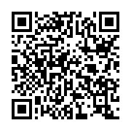
IHE PaLM - ex of laboratory interoperability Framework
https://wiki.ihe.net/index.php/Pathology_and_Laboratory_Medicine_(PaLM)
DISCLAIMER: NOT an IHE Expert!!
STANDARDS
Make meaning consistent.
MODELS
Define Data Needs
Driven by Use cases
04
02
03
GOVERNANCE
01
Maintain and improve.
EXCHANGE
Move data in workflow context.
Notes:
So now let’s look at how this played out in the human diagnostic laboratory domain – IHE PaLM - Disclaimer!
IHE (Integrating the Healthcare Enterprise) is a global healthcare interoperability initiative that defines practical implementation guides, called Integration Profiles, to help information systems exchange and use data consistently across organizations and vendors. Kind of sounds like what you all want to accomplish in the US right? Except admittedly they as an organization are tackling more than just lab domain
PaLM is their Pathology and Laboratory Medicine domain.
If we look at their development process you’ll find that it follows this pathway.

Slide 16
IHE PaLM - ex of laboratory interoperability Framework
https://wiki.ihe.net/index.php/Pathology_and_Laboratory_Medicine_(PaLM)
STANDARDS
MODELS
Make meaning consistent.
Define Data Needs
Driven by Use cases
SCOPE
04
Anatomic pathology, clinical labs,
and point-of-care testing
02
03
GOVERNANCE
01b
01a
Maintain and improve.
EXCHANGE
USE CASES
Move data in workflow context.
Laboratory Analytical Workflow,
Sharing Laboratory Reports,
Specimen Barcode Labeling…
Notes:
To define the data needed, they started with setting scope. I can’t tell you which they started with, but these are the 3 domains they currently have profiles for.
Within these scopes, they focused on Use Cases.
IMPORTANT POINT: First step is always defining the needs

Slide 17
IHE PaLM - ex of laboratory interoperability Framework
https://wiki.ihe.net/index.php/Pathology_and_Laboratory_Medicine_(PaLM)
STANDARDS
Make meaning consistent.
PROFILES
MODELS
Define Data Needs
Driven by Use cases
Integration Profiles
organize priorities, formalize standards
SCOPE
04
Anatomic pathology, clinical labs,
and point-of-care testing
02
03
GOVERNANCE
01b
01a
Maintain and improve.
EXCHANGE
USE CASES
Move data in workflow context.
Laboratory Analytical Workflow,
Sharing Laboratory Reports,
Specimen Barcode Labeling…
Notes:
From those Use Cases, they then selected the standards and created Profiles which organized priorities and provided a formal understanding of what data would be included and how it would be structured.
IMPORTANT POINT: Once data needs are understood, THEN and only then can we determine how to standardize it.

Slide 18
IHE PaLM - ex of laboratory interoperability Framework
https://wiki.ihe.net/index.php/Pathology_and_Laboratory_Medicine_(PaLM)
STANDARDS
Make meaning consistent.
PROFILES
MODELS
Define Data Needs
Driven by Use cases
Integration Profiles
organize priorities, formalize standards
SCOPE
04
Anatomic pathology, clinical labs,
and point-of-care testing
02
03
GOVERNANCE
01b
01a
FRAMEWORK
Maintain and improve.
USE CASES
Detailed technical guidance
documents for profiles.
Laboratory Analytical Workflow,
Sharing Laboratory Reports,
Specimen Barcode Labeling…
EXCHANGE
Move data in workflow context.
Notes:
With profiles in hand, they can then provide technical guidance on how to put these into use…. This the framework piece. How does it all fit together.

Slide 19
IHE PaLM - ex of laboratory interoperability Framework
https://wiki.ihe.net/index.php/Pathology_and_Laboratory_Medicine_(PaLM)
STANDARDS
Make meaning consistent.
PROFILES
MODELS
Define Data Needs
Driven by Use cases
Integration Profiles
organize priorities, formalize standards
SCOPE
04
Anatomic pathology, clinical labs,
and point-of-care testing
02
STEWARDSHIP
03
01b
International committees
develop and maintain it.
01a
FRAMEWORK
USE CASES
Detailed technical guidance
documents for profiles.
GOVERNANCE
Maintain and improve.
Laboratory Analytical Workflow,
Sharing Laboratory Reports,
Specimen Barcode Labeling…
EXCHANGE
Move data in workflow context.
Notes:
And finally, and potentially most important – The put governance in action by continuing to develop and maintain.
IMPORTANT POINT – While Governance is the last in my pathway….don’t wait to determine how this is going to happen. This is one of those chicken and egg moments. Governance really needs to be both at the beginning and at the end to be successful.

Slide 20
REUSE THE PATTERNS -- ADAPT THE MODEL
POTENTIALLY REUSE - PaLM:
Workflow profiles and use cases
Actors and transactions
Message and report structures
Laboratory code-set distribution
Status, errors, and specimen tracking
ADAPT:
Multiple species
Herd, flock, and premises concepts
Pooled samples
Surveillance programs
Regulatory workflows
Population-level testing
Notes:
Now can we use more than just their pattern of development? Most likely yes there are probably areas that we can use their work to at least guide us, but there are also just as many areas that veterinary diagnostic labs will have unique issues, where adaptation needs to happen.
IMPORTANT POINT: IHE PaLM is not a blueprint. It won’t fasttrack the work. We still need to do the hard work of determining needs, etc etc. But it can serve as a resource during that development.

Slide 21


What about U.S. Efforts??
ONC Report:
Standards for Electronic Ordering and Reporting of Laboratory Test Results
Systemic Harmonization and Interoperability Enhancement for Laboratory Data
Notes:
Well, there are a couple of interesting resources in the US.
Office of the National Coordinator for Health Information Technology, which produces the USCDI (United States Core Data for Interoperability) a standardized set of health data classes and data elements to support nationwide, interoperable exchange of eHealth information. Presented a report to Congress on Standards for Electronic Ordering and Reporting of Lab Test results.
There is also the FDA-led collaboration involving federal, academic and industry stakeholders, addressing clinical and semantic interoperability of InVitro Diagnostic data across the laboratory data life cycle.

Slide 22
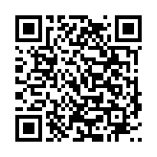
What about U.S. efforts??
ONC Report: Standards for Electronic Ordering and Reporting of Laboratory Test Results
https://www.govinfo.gov/app/details/CMR-HE1-00196380
KEY TAKEAWAYS:
Map the workflow to identify data needs and handoffs.
Anticipate gaps in data capture and exchange.
Evaluate existing standards and resources for potential reuse.
Plan implementation with lessons on coding, testing, and support.
A human-health reference to guide as our veterinary framework develops.
Sources: ASTP/ONC Report to Congress (2024), pp. 12–24, 33–34
Notes:
The ONC report concludes that standards for electronic laboratory ordering and reporting exist and are widely used, but inconsistent adoption and implementation continue to limit interoperability. It recommends greater standardization, modernization of laboratory information systems, and stronger support for standards-based data exchange to improve the flow of laboratory information across the healthcare ecosystem.
So not really a short cut for us either, but maybe useful as a reference during requirements definition, standards evaluation and implementation planning.
Sort of a “words of wisdom on what should be”.

Slide 23
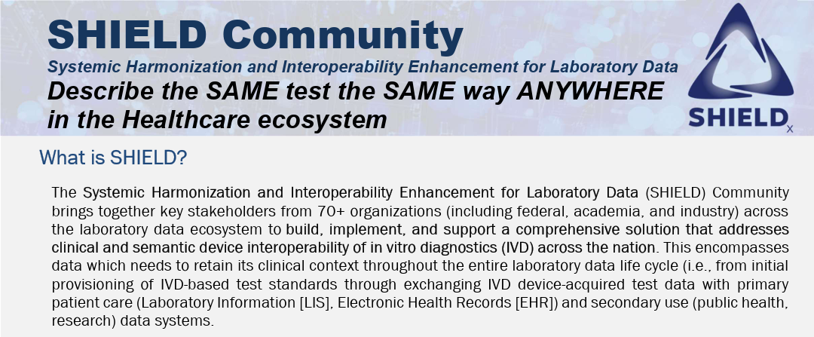
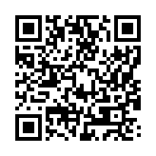
What about US efforts??
https://aphlinformatics.atlassian.net/wiki/spaces/SC/overview
Notes:
SHIELD serves as a national laboratory-data harmonization collaborative, bringing stakeholders together to promote consistent implementation of standards and resolve semantic interoperability challenges across the laboratory ecosystem. It’s a governance example really.
A veterinary diagnostic lab interoperability framework needs not only standards (VetSCT, SNOMED CT, LOINC, HL7/FHIR) but also a SHIELD-like governance process where laboratories, vendors, and standards experts regularly work through implementation issues and semantic mapping challenges.

Slide 24
THis SYMPOSIUM:
DEFINE THE PATH WITHOUT FINISHING THE FRAMEWORK
STARTING POINT—
NOT FINAL DESIGN.
Step 1
Step 3
Step 4
Step 2
Aim for enough shared direction to decide whether a working draft is warranted—and what work must come first.
SCOPE
Set boundaries
USE CASES
Prioritize value
INFO
Define requirements
NEXT WORK
Name gaps and owners
Notes:
So if we come back to where we are today….. At This Symposium… This is where I’d like to see us get.
Scope, begin discussing Use Cases so we can start to define requirement….and Set up a plan for next steps to continue the work, define governance etc.

Slide 25
THANK YOU
Julie Green, DVM, MS
jmgreen@vt.edu
IHE PaLM
ONC Report
SHIELD
wiki.ihe.net/index.php/
Pathology_and_Laboratory_
Medicine_(PaLM)
www.govinfo.gov/app/details/
CMR-HE1-00196380
aphlinformatics.atlassian.net/
wiki/spaces/SC/overview

Slide 26
AAVLD / INFORMATICS SYMPOSIUM
FEATURED PRESENTATION
SESSION 03
Defining Veterinary Diagnostic Laboratory Interoperability
Dr. Michael Dark

Slide 27
Why Interoperability?

Slide 28
Current Environment
AAVLD labs do well in production and agricultural scenarios
  High volume, low margins
Private labs take a higher percentage of small animal cases
  Lower volumes per case, high margins

Slide 29
Their Advantages
In clinics already
  The companies that provide lab services also supply many of the hospital EMR systems used
  They also provide in-clinic analyzers, frequently with an agreement about special pricing for submitted labwork
Courier services

Slide 30
What are OUR advantages?
Quality
Connections
  We’re all here at the meeting!
Expertise

Slide 31
Interoperability lets us leverage our advantages
Submit tests to each other
  Makes it easier to request specialty testing
  Makes it easier to cope with equipment downtime while meeting accreditation requirements
Decrease staff time and effort

Slide 32
AAVLD / INFORMATICS SYMPOSIUM
FEATURED PRESENTATION
SESSION 04
Framework Component 1: Publishing Laboratory Tests & Services and Electronic Ordering
Emily Hashey

Slide 33
Publishing Laboratory
Tests and Services
AAVLD 2026 · INTEROPERABILITY SYMPOSIUM
FRAMEWORK COMPONENT 1
A shared, machine-readable catalog is the starting point for every order, accession and result.
Emily Hashey · October 15, 2026
Notes:
[0:00 · about 30 seconds] Good morning! My name is Emily Hashey on behalf of SynapticSci. This session is about the first building block of the interoperability framework: how a laboratory publishes what it offers, including its tests and services in a form other systems can use. I’ll walk through five problems we see today. For each one I’ll give a proposed solution and the talking points we should think about as a group. The goal isn’t to present a finished answer, but to foster discussion on the topic and hopefully build the groundwork for a future solution.

Slide 34

Every exchange starts with a catalog entry
CONTEXT
COMPONENT 1
COMPONENT 2
COMPONENT 2
COMPONENT 3
Catalog
Order
Accession
Result
Defines each offering and what it requires
Cites the offering’s identifier and supplies its required information
Checks the specimen against the offering’s requirements
Reports the analytes and units the offering defines
Today’s three components run from a catalog entry to an amended result. If the catalog is ambiguous, every later step is too.
Framework Component 1 · Publishing Laboratory Tests and Services
02
Notes:
[0:00–0:02 · 2 minutes] Before the problems, I want to provide some context as to why this is a necessary discussion to foster interoperability. Every exchange in this framework points back to the test catalog. An order cites an offering in the catalog. Accession checks the specimen against that offering’s requirements. A result reports the analytes and units that offering defines. Ordering, accession and results are Components 2 and 3 later today that Tammy and Sarah will pick up from here. So, the catalog is the reference point for everything that follows. If the process starts ambiguous, it makes it difficult to keep a clean chain of events that come after. (Point along the four boxes, left to right.)

Slide 35
Current Problems & Proposed Solutions
OVERVIEW
1
Test menus are documents, not data
Give every catalog entry the same content model
2
Codes and names differ at every lab
Map local codes to shared terminology
3
Orders fail on requirements after the samples are received
Publish specimen, species and use requirements in a checkable form
4
Submitters’ copies go stale
Version every entry, with status and effective dates
5
Every interface is built from scratch
Define the model apart from any technology, with FHIR as the first mapping
Framework Component 1 · Publishing Laboratory Tests and Services
03
Notes:
[0:02–0:04 · 2 minutes] Here is a quick overview of the problems I want to discuss. While I do have some proposed solutions, these are just that - proposed. The more opinions and feedback we can gather from experts in the field, the better solution we will be able to achieve and hopefully make a lasting impact on the industry. The “to decide” for each problem is the detail we will need to gather for any next steps. We don't need finite decisions on anything today, but rather the goal is to plant the seed of thought and foster a collaborative discussion. I’ll take a quick reaction after each problem, but the main discussion is at the end, when all five decisions come back together. So please hold your bigger points, and jot them down as we go.

Slide 36
Test menus are published for people, not systems
PROBLEM 1 OF 5
Menus and submission guides live in PDFs and web pages. Every submitter re-keys them and keeps their own copy current.
PROPOSED SOLUTION
DECISION FOR THIS GROUP
Publish each offering as a structured catalog entry
One content model across labs: identity, applicability, specimen, method and outputs, ordering rules, status, context
Names and synonyms, so submitters find tests by the terms they use
What is the minimum set of fields every published offering must include?
Do panels and reflex testing need their own structure? Does accreditation scope belong in the entry?
Framework Component 1 · Publishing Laboratory Tests and Services
04
Notes:
[0:04–0:07 · 3 minutes] The first problem is the most basic one. Our test menus and submission guides are written for people, not systems. This makes it difficult for uniform, machine-powered submission entry and review. While I do not recommend switching catalogs to binary to make it easiest for computers (pause for laugh), they currently live in PDFs and on web pages, which makes it difficult for direct entry into informatics systems. Every clinic, every practice-software vendor and every referring lab has to read them, re-key them into their own systems, and then has to keep that copy current on their own. The proposed solution is to publish each offering as a structured catalog entry, using one content model across laboratories. Seven groups of fields to span identity, applicability, specimen, method and outputs, ordering rules, status, and context. And this should include names and synonyms, because submitters search by the names they know, not necessarily the exact names in the system. Now with this comes several discussion points, but the first step is to identify what the minimum set of fields that published offerings should include. This allows for a level of consistency across the board, and enables us to test a smaller subset of requirements that larger labs can expand upon as desired. Is there anything on that list you would not publish, or anything missing?

Slide 37
The same test has a different code and name at every lab
PROBLEM 2 OF 5
A submitter’s system cannot recognize the same test across laboratories or compare what each one offers.
PROPOSED SOLUTION
DECISION FOR THIS GROUP
Labs keep their local codes
Map each to shared terminology: LOINC for tests, SNOMED CT for specimens and species, NAHLN for programs
Record each mapping’s source and version
Local codes mapped to shared terms, or a shared registry of identifiers?
Who maintains the mappings, and how are gaps in veterinary coverage filled?
Framework Component 1 · Publishing Laboratory Tests and Services
05
Notes:
[0:07–0:10 · 3 minutes] The next problem I want to discuss is that the same test has a different code and a different name at every laboratory. That’s fine inside one lab. But a submitter’s system can’t tell that two labs offer the same test, or compare what they offer. The proposal doesn’t ask anyone to give up local codes, because many systems and protocols are already built around these codes and this would likely require a large amount of restructuring. Labs keep their local codes, but map each one to shared terminology. Examples could include LOINC for tests, SNOMED CT for specimens and species, and NAHLN for programs and reporting. Each mapping records its source and version, so it can be checked and updated as the industry evolves. I want to be candid: veterinary coverage in these terminologies is uneven. Some of our tests have no good shared code today. So, we need some input here from you all. The first question is do we map local codes to shared terms, or create a shared registry of identifiers for veterinary offerings? A registry is simpler for submitters, but it needs someone to run it. Either way: who maintains it, and how do we fill the gaps? (Invite anyone working on veterinary terminology to weigh in.)

Slide 38
Orders fail on requirements after samples are received
PROBLEM 3 OF 5
Specimen requirements, valid species and intended use are written as prose or simply implied. Problems surface only when the sample reaches accession.
PROPOSED SOLUTION
DECISION FOR THIS GROUP
Specimen requirements as checkable fields: type, amount, container, handling, transport, stability
Species, populations and intended use as coded values
Rejection criteria stated explicitly
Which requirements must be published in a checkable form?
How finely are species and populations coded? Which checks reject an order, and which only warn?
Framework Component 1 · Publishing Laboratory Tests and Services
06
Notes:
[0:10–0:16 · 6 minutes] Third problem, and arguably the one that affects lab personnel most day to day which is that orders fail on requirements the lab knows but hasn’t published in a form that submitters can check. There are two kinds of requirements. First, the specimen, such as what to collect, how much, in what container, how to handle and ship it, and how long it stays usable. Second is applicability. Which species and populations is the test valid for, and what is it intended for: diagnostic, surveillance, regulatory or export? Today most of that is prose, or simply assumed. So the problem is instead found at accession, after the sample has travelled, and sometimes after an animal has to be sampled again. The proposal would be to publish specimen requirements as checkable fields; code species, populations and intended use; and state rejection criteria explicitly. If we would reject it at the bench, it should be in the catalog. This proposal opens up a few questions: Which requirements must be checkable? How finely do we code species and populations: species only, or age or production class, and individual versus pooled or herd-level testing? And which checks should reject an order outright, versus warn the submitter and let a person on the accessioning side decide? (Prompt: “Which sample requirements do your lab already publish in a structured way?”)

Slide 39
Catalogs change, and every copy goes stale
PROBLEM 4 OF 5
When a lab changes a container, a method or a test, submitters’ copies don’t change with it. Retired codes keep arriving.
PROPOSED SOLUTION
DECISION FOR THIS GROUP
Version every entry, with effective dates
Mark status: active, retired, or replaced by another offering
Treat publishing a catalog change as a controlled change, under the lab’s change control
What kind of change makes a new version, and what makes a new offering?
How are submitters told about a change?
Framework Component 1 · Publishing Laboratory Tests and Services
07
Notes:
[0:16–0:19 · 3 minutes] The fourth issue is that, like most things these days, catalogs change. We change a container, adopt a new method, retire a test... the list goes on. Our own systems update, but every submitter’s copy is now out of date, and old codes continue arriving. The proposal here would be to version every catalog entry, with effective dates. Mark its status as active, retired, or replaced by another offering. And treat publishing a catalog change as a controlled change, under the same change control we already apply to our other systems. Effective dates matter for more than ordering. They let anyone reconstruct which version applied to a past order, which matters for corrections and audits. With this proposal, we have to decide what kind of revision requires a change to an existing offering vs. what the ground are for making a new offering? We could rule that a new container requirement would be a new version vs. a new method or a different analyte is a new offering. But I am curious to hear everyone's opinions here. How do your submitters find out about a change? Ideas include a subscription, polling, or published change notices?

Slide 40
Every lab–partner connection is built from scratch
PROBLEM 5 OF 5
Without a shared model, each interface is a one-off project between one laboratory and one partner.
PROPOSED SOLUTION
DECISION FOR THIS GROUP
A technology-neutral model defines meaning and exchange behavior
HL7 FHIR as the first mapping: ActivityDefinition, PlanDefinition, SpecimenDefinition, ObservationDefinition
FHIR is not mandatory; other implementations stay possible
Is FHIR the right first mapping, and are these the right resources?
What would your LIMS need in order to publish this?
HL7® and FHIR® are registered trademarks of Health Level Seven International. Use does not imply endorsement.
Framework Component 1 · Publishing Laboratory Tests and Services
08
Notes:
[0:19–0:22 · 3 minutes] The last problem I want to cover today is that every connection between a laboratory and a partner requires its own project. Different formats and different mappings have to be built one at a time. The proposal separates the model from the technology. The framework defines what an offering means and how the exchange behaves, independent of any one standard. HL7 FHIR is the first technology we’d map it to and test it with, following the HL7 order-catalog pattern: an offering as ActivityDefinition, a panel as PlanDefinition, specimen requirements as SpecimenDefinition, and outputs as ObservationDefinition. FHIR is not mandatory. A lab that doesn’t use FHIR isn’t excluded from the efforts, but this way we can get the model first for how to apply this effort to other connections. The question at hand would be if FHIR is the right first mapping, and are these the right resources? And for the LIMS and interface people in the room: what would your system need in order to publish this? (This audience knows FHIR; keep the explanation short and invite challenge on the mapping.)

Slide 41
One catalog entry with the proposals applied
PUTTING IT TOGETHER
Example Laboratory · EXL-1042
Synthetic · illustrative values
Version
1
Specimen
Ear notch tissue, fresh, in a dry sterile tube
Name
Bovine viral diarrhea virus (BVDV) RT-PCR
Handling
Refrigerated; arrives within 72 hours
Kind
Single test
Rejected
Formalin-fixed tissue
Species
Cattle
Method
Real-time RT-PCR
Use
Diagnostic
Result
BVDV RNA: Detected or Not detected
Status
Active from 10/15/2026; replaces EXL-1007
Turnaround
3 business days
Framework Component 1 · Publishing Laboratory Tests and Services
09
Notes:
[0:22–0:25 · 3 minutes] With all of that said, this is what all of our solutions look like together. This is a mockup entry from a fictional Example Laboratory. The values are illustrative; please don’t read them as a recommendation for how to run this test. Read it the way a submitter would. What is it? A BVDV RT-PCR as a single test. Is it right for my animal? Cattle, for diagnostic use. What do I collect, and how do I ship it? Fresh ear notch tissue in a dry sterile tube, refrigerated. What won’t they accept? Formalin-fixed tissue. What do I as the submitter get back, and when? Detected or not detected, in 3 business days. And the status line: this entry replaced EXL-1007. That’s already problem 4 in action. Every one of these fields is something a submitter’s system can check before the sample ships to avoid unnecessary re-sampling, re-submittals, and cutting down on paperwork. Is there anything here you would change or add that a submitter would find useful?

Slide 42
What the catalog lets a system catch before shipping
PUTTING IT TOGETHER
UNKNOWN OFFERING
RETIRED OFFERING
Order cites EXL-9999
Order cites EXL-1007
Rejected: no such offering in this catalog
Flagged: retired, replaced by EXL-1042
SPECIES NOT LISTED
SPECIMEN NOT ACCEPTED
EXL-1042 ordered for a goat
Ear notch submitted in formalin
Flagged: offering is listed for cattle only
Rejected: formalin-fixed tissue not accepted
Framework Component 1 · Publishing Laboratory Tests and Services
10
Notes:
[0:25–0:28 · 3 minutes] And here’s what that buys us: an example set of four orders, each caught by reading one field of the catalog. An order that cites a code that doesn’t exist is rejected, since there is no such offering. An order that cites a retired code is flagged, with a pointer to its replacement. The test ordered for a goat is flagged, because the entry lists cattle only. And an ear notch arrives in formalin is rejected, because the entry says formalin-fixed tissue isn’t accepted. Notice the difference between rejected and flagged. Some checks should stop an order; others should warn and let a submitter decide and provide additional context if needed. Duplicate submissions and cancellations matter too, but they’re about how orders behave, so I’ll leave those to Tammy for discussion later.

Slide 43
What this group needs to decide
DISCUSSION
1
Content model. The minimum fields every offering must include
2
Terminology. Mapping or a shared registry, and who maintains it
3
Requirements. What must be checkable, how finely species are coded, and reject or warn
4
Change. New version or new offering, and how submitters are told
5
Implementation. FHIR as the first mapping, and the resource fit
Framework Component 1 · Publishing Laboratory Tests and Services
11
Notes:
[0:28–0:39 · 11 minutes, the main discussion] So here are the five decisions in one place. This is where we need you. (Pause.) Let’s start with [the decision that drew the strongest reaction earlier]. Facilitation: if the room is quiet, start with 1 and 2; they’re the most foundational. Give each about two minutes. For each, aim for one of three outcomes: rough agreement, a clear split to bring to the consensus session, or a question to track afterward. Don’t try to close all five. Make sure the recorder captures each outcome. Fallback prompts: 1. “What is the one field you couldn’t live without?” 2. “If we had a shared registry, who would run it?” 3. “Where should a borderline specimen get a warning rather than a rejection?” 4. “What change at your lab would you call a new test, rather than a new version?” 5. “What would your LIMS or vendor need to support this?”

Slide 44
From Test Request to
Laboratory Accession
NEXT · FRAMEWORK COMPONENT 2
Now that an offering is published, how does a request for it become an accession?
Thank you · Emily Hashey · emily.hashey@synsci.com
Notes:
[0:39–0:40 · 1 minute] To pull it together: the catalog is the reference point for everything that follows. If we agree on what a laboratory publishes, ordering and results have something solid to point to. Which brings us to the next question: once an offering is published, how does a request for it become an accession? Tammy Leimer will take that up after the break. Thank you all so much for your time and input and I look forward to seeing what we can accomplish together!

Slide 45
AAVLD / INFORMATICS SYMPOSIUM
BREAK
Break
Meet back at 10:15 for our next speaker

Slide 46
AAVLD / INFORMATICS SYMPOSIUM
FEATURED PRESENTATION
SESSION 05
Framework Component 2: Test Requests, Accessions, and Communication
Tammy Leimer

Slide 47
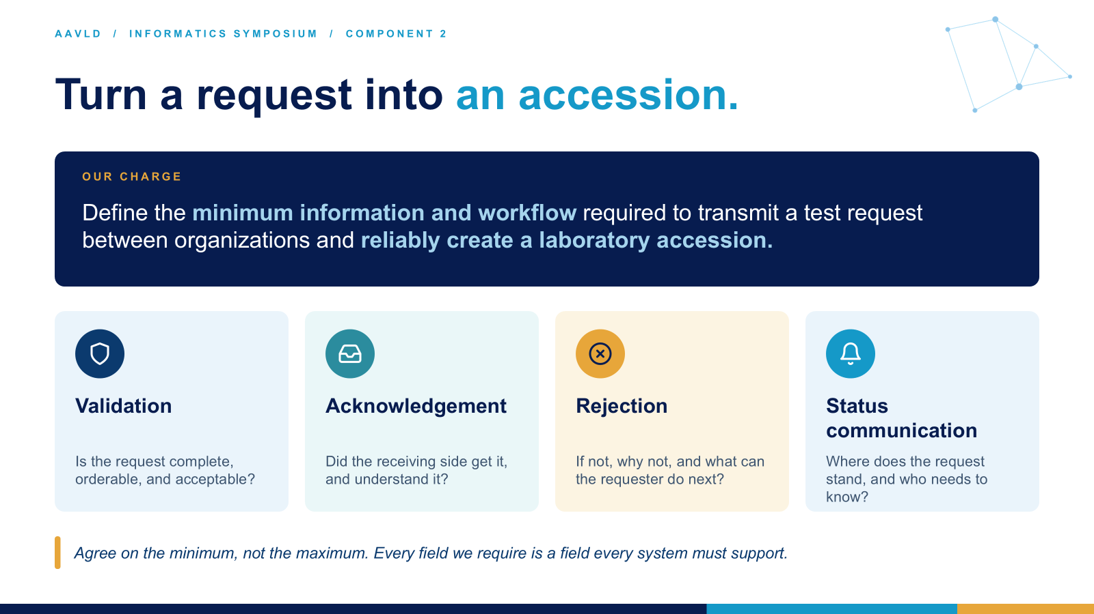

Slide 48
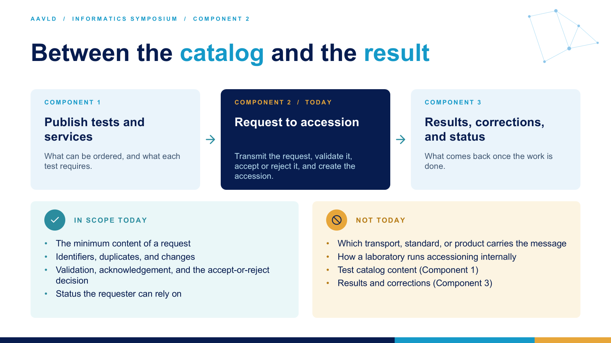

Slide 49
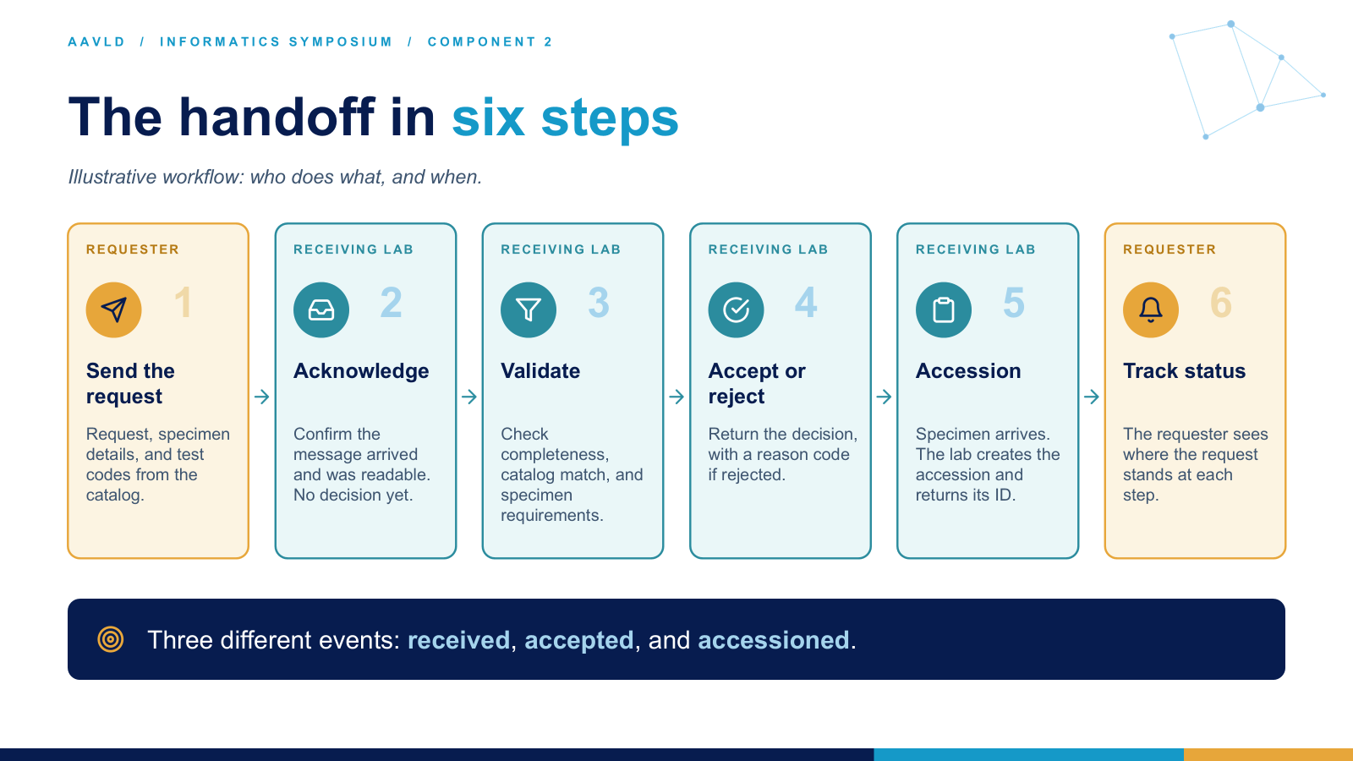

Slide 50
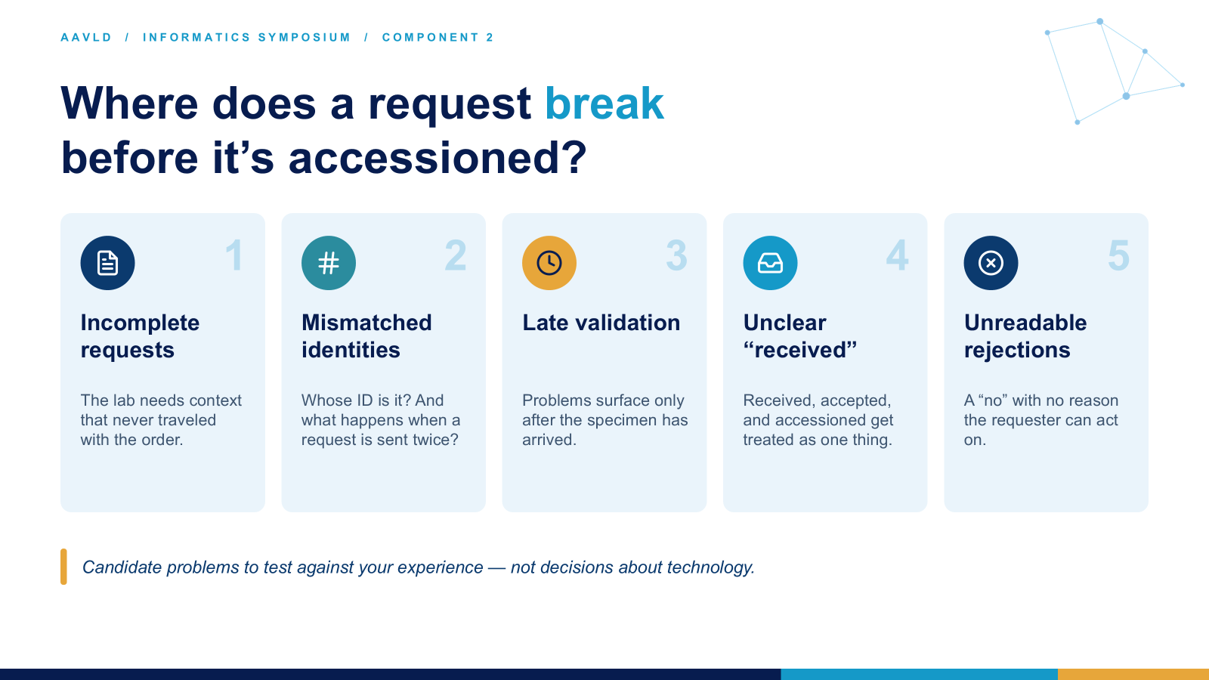

Slide 51
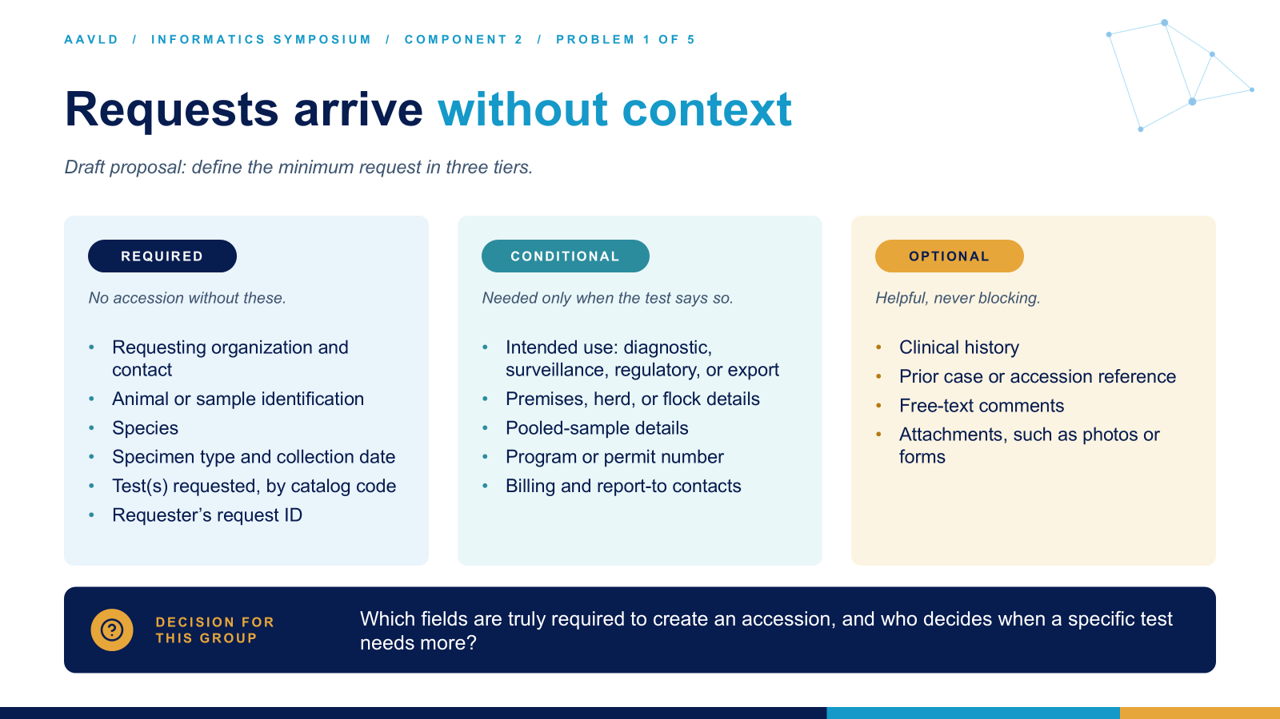

Slide 52
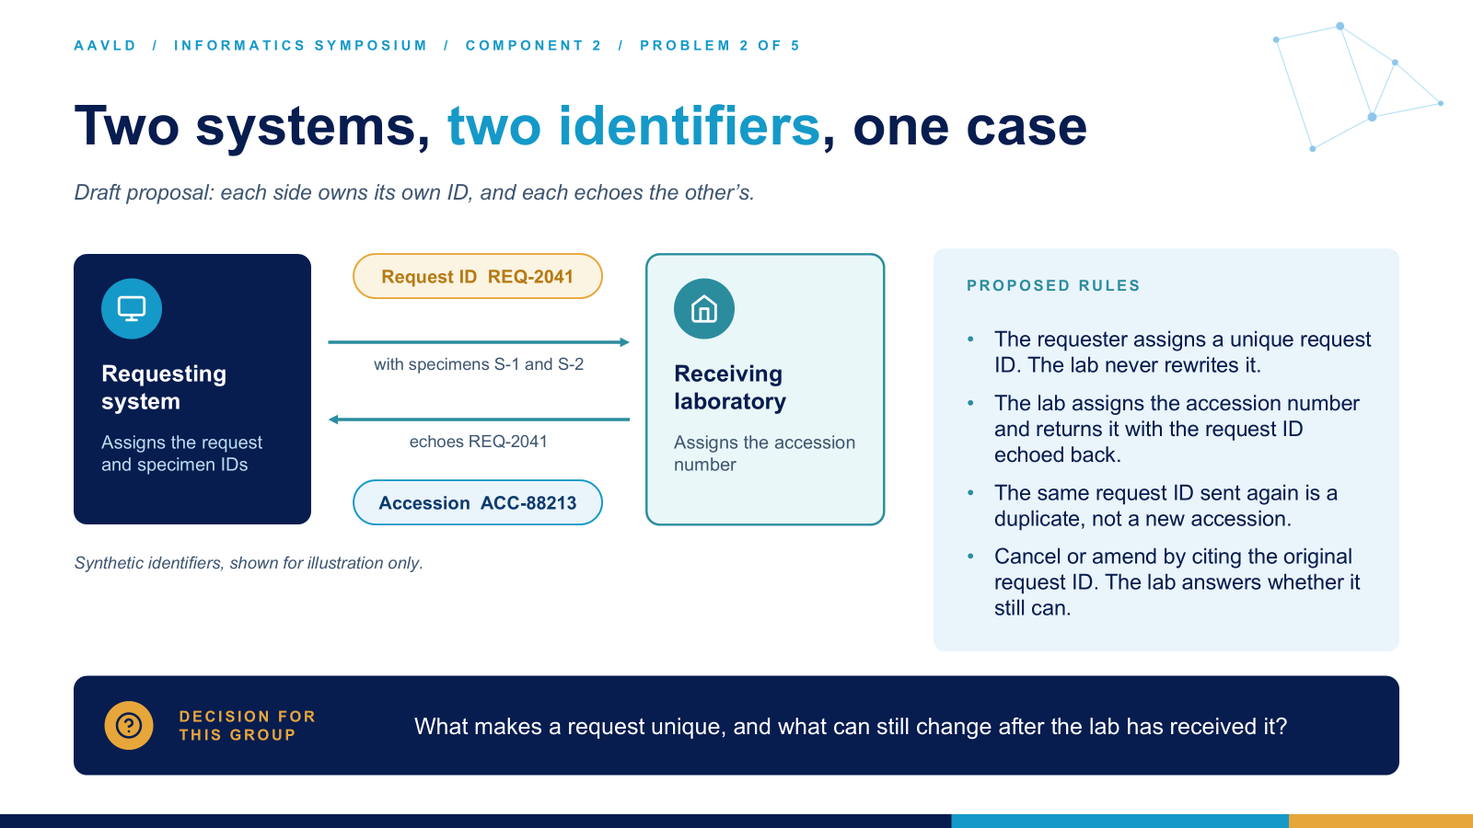

Slide 53
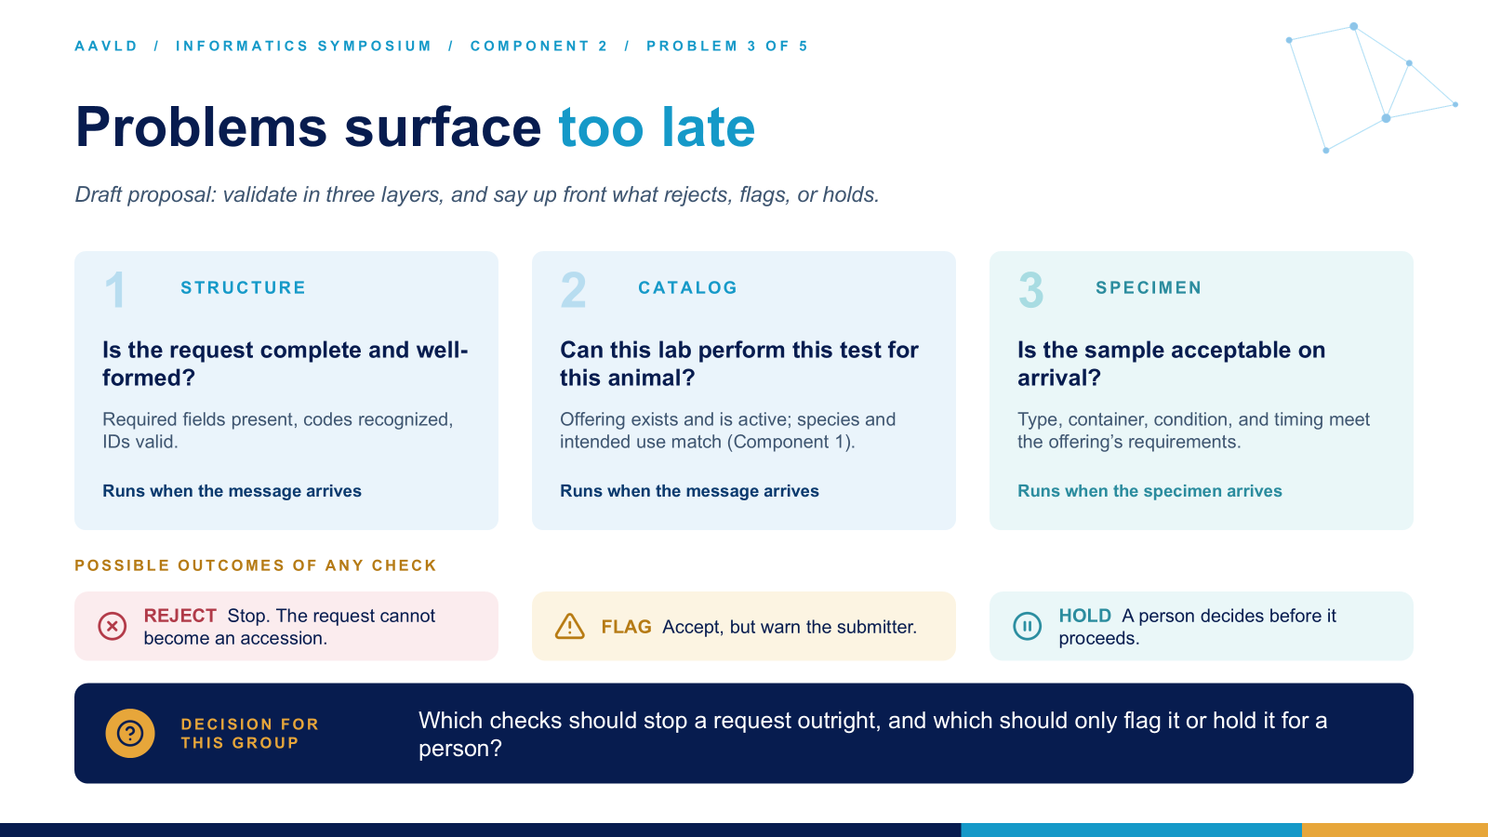

Slide 54
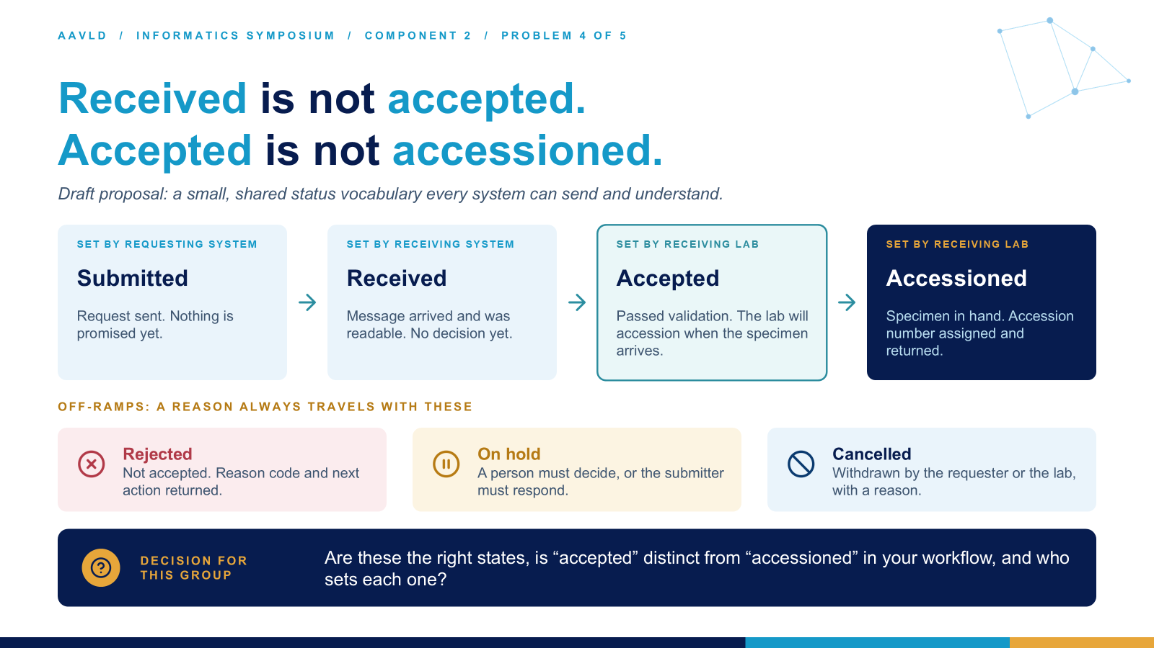

Slide 55
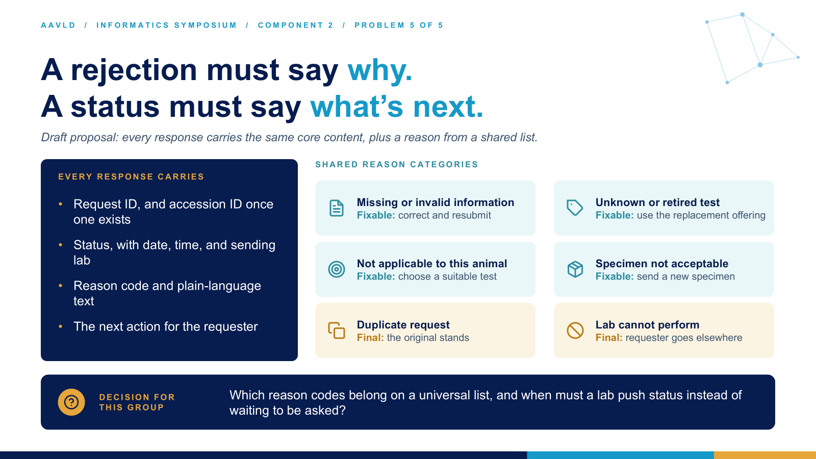

Slide 56
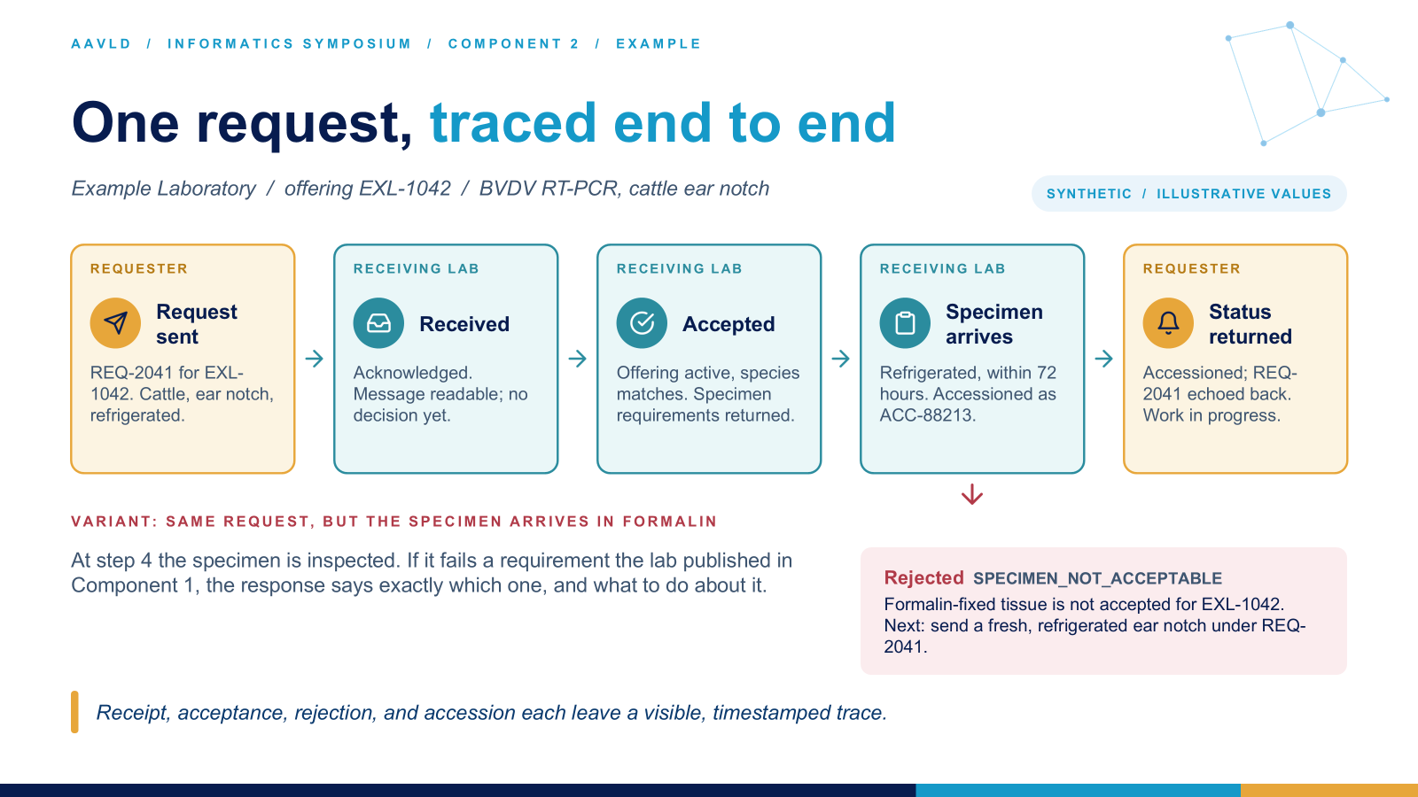

Slide 57
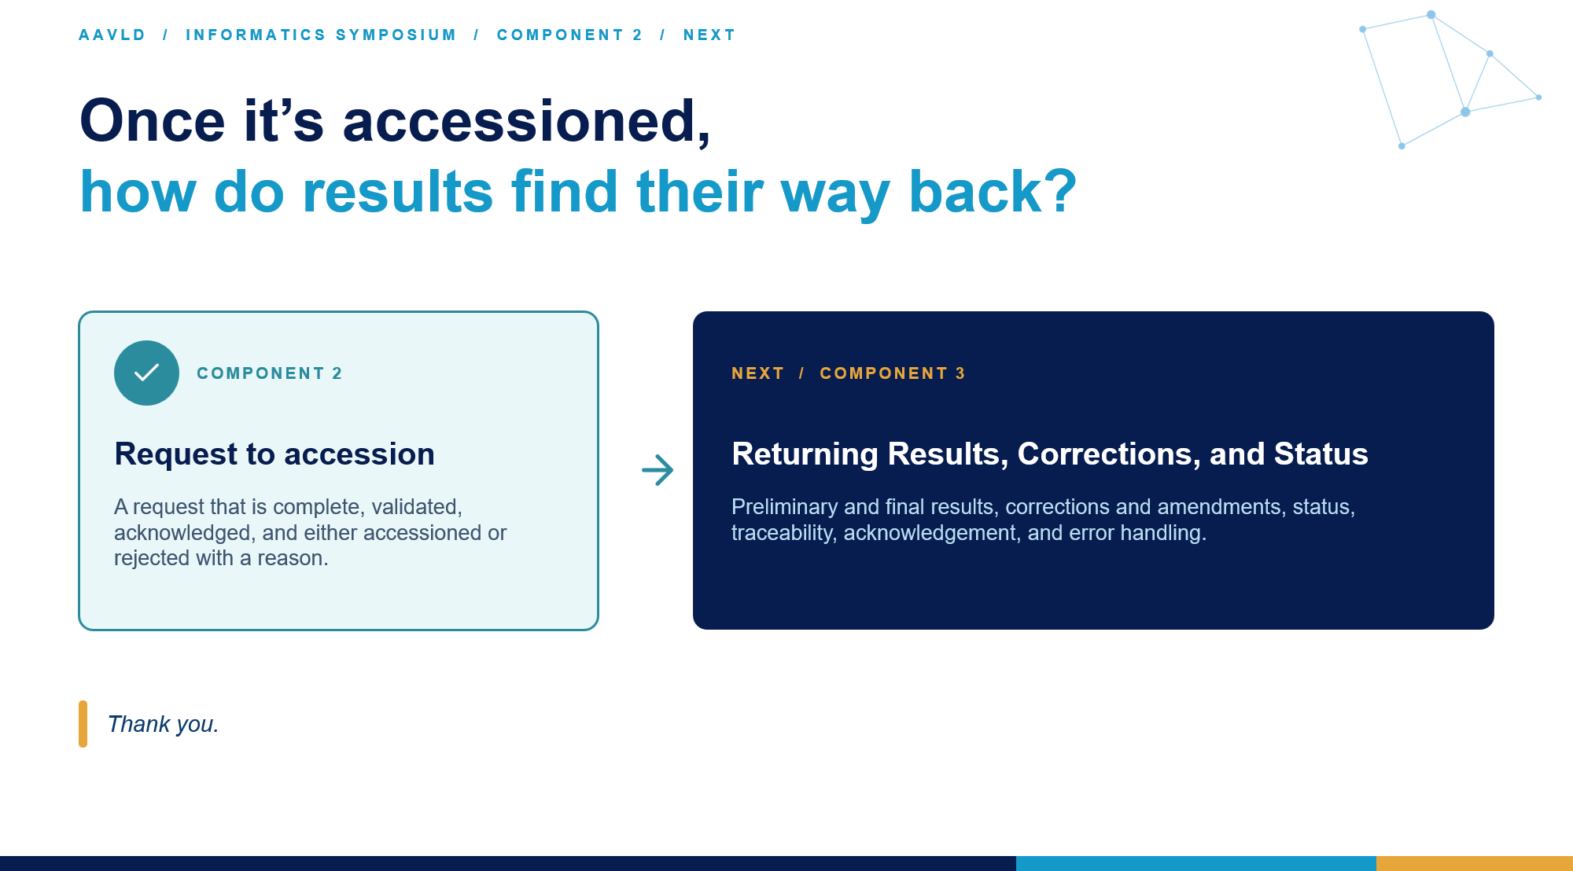

Slide 58
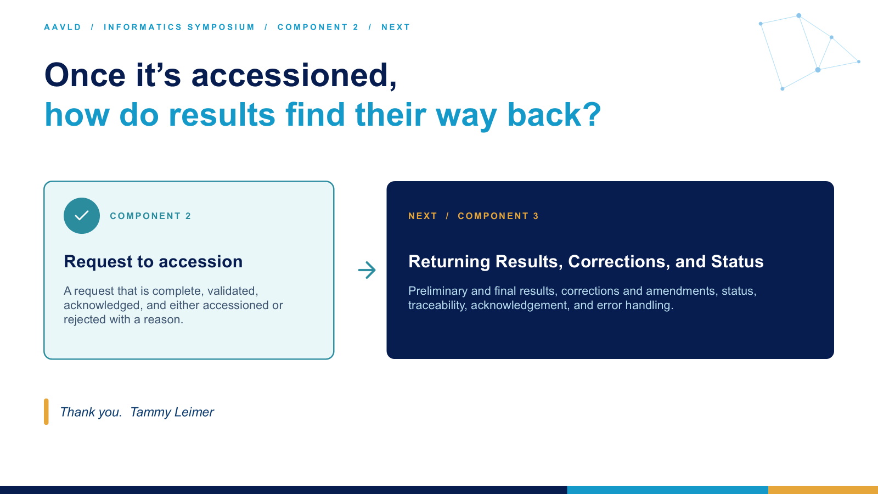

Slide 59
AAVLD / INFORMATICS SYMPOSIUM
FEATURED PRESENTATION
SESSION 06
Framework Component 3: Results, Corrections, and Status
Sarah Tomlinson

Slide 60
AAVLD Informatics Committee Symposium
Interoperability Framework Discussion
Sarah Tomlinson, DVM
Colorado State University
Veterinary Diagnostic Laboratories

Slide 61
Framework Component 3
Returning Results, Corrections, and Status

Slide 62

Our Charge
Define expectations for electronic results exchange throughout the result lifecycle, including preliminary and final results, corrections and amendments, status, traceability, acknowledgement, and error handling.

Slide 63

Our Approach
Define expectations for electronic results exchange throughout the result lifecycle, including preliminary and final results, corrections and amendments, status, traceability, acknowledgement, and error handling.
Step 1: Define and scope
Step 2 : Identify current standards/capabilities
Step 3: Determine gaps
Step 4: Define Path Forward
Step 5: Next steps
Notes:
As we heard from Dr. Green, before we jump into functional requirements- let’s set a reasonable expectation for today and start by defining the ‘what’.
So, let’s make sure we understand what we want to include, remind ourselves what is ‘out there’ that we already use and be a bit creative thinking about what we can use.
Then we’ll have a good sense about what our gaps are, then specifically what we need to move forward. With hopefully, a plan/list of action item so move us forward.

Slide 64
Step 1: Define and Scope
Let’s get on the same page:
Define expectations for electronic results exchange throughout the result lifecycle, including preliminary and final results, corrections and amendments, status, traceability, acknowledgement, and error handling.
What do we mean specifically?
What is our desired outcome? Does this capture what is needed for this component of the framework (Results, Corrections and Status)?
What is in scope? What is out of scope?

Slide 65
Determine Applicable Result Lifecycle States
State | Purpose | Action Expected
Ordered | Test request created | Identifier assigned
Collected/In Process | Specimen received or processing underway | Status updates may be transmitted
Preliminary | Early result available but not final | Clearly labeled as non-final
Final | Complete and verified result | Replaces preliminary result
Corrected | Previous final result changed due to identified error | Original result retained in audit history
Amended | Additional information added without invalidating original result | Amendment linked to original result
Cancelled/Voided | Result withdrawn or test not completed | Reason communicated
Notes:
For example- when we are talking about results- do we include preliminary, or start at the final stage?

Slide 66
Step 2 : Identify current standards/capabilities
Now that we have defined what we are targeting:
What do we have in place/in practice already?
What are we working on?
What other capabilities are we aware of that we can we leverage?

Slide 67

Some Current Capabilities
NAHLN Standards and messaging
HL7 version 2.x
HL7 FHIR
XML
DICOM
AHRMS
LOINC
SNOMED
Middleware?
Notes:
We do have many current standards and capabilities that we use everyday for our data exchanges.
What applies here?

Slide 68
Step 3: Determine gaps
We’ve discussed what we have and what other capabilities we could apply:
What are we missing?
What else do we need that don’t we have capabilities for?
Are there other gaps that need addressed?

Slide 69

Step 4: Define path forward
We know where we are going; we know what we have and what we don’t have:
How do we want to move forward?
What do we need to move forward?

Slide 70
Determine Applicable Result Lifecycle States
State | Purpose | Action Expected
Ordered | Test request created | Identifier assigned
Collected/In Process | Specimen received or processing underway | Status updates may be transmitted
Preliminary | Early result available but not final | Clearly labeled as non-final
Final | Complete and verified result | Replaces preliminary result
Corrected | Previous final result changed due to identified error | Original result retained in audit history
Amended | Additional information added without invalidating original result | Amendment linked to original result
Cancelled/Voided | Result withdrawn or test not completed | Reason communicated
Notes:
Suggest:
For each one of these result states we want to include- define functional requirements and business rules

Slide 71
Define Controlled Vocabulary for Each State
Status definitions must be consistent across sending and receiving systems.
Status Definitions of:
Preliminary
Partial
Final
Corrected
Amended
Cancelled
Error

Slide 72
Define Functional Requirements and Business Rule(s) for Each State
Preliminary Results
Final Results
Corrected Results
Amended Results
Cancelled/Voided Results
For example: Final Results:
Requirements
Final results represent the authoritative clinical record.
Every final result must:
  Maintain the same business identifier as prior preliminary versions.
  Include finalization date/time.
  Identify the responsible laboratory/system.
  Be traceable to the originating order and specimen.
Business Rule
Receipt of a final result supersedes all prior preliminary versions while preserving historical traceability.
Invalid transitions must be rejected, returned and notification sent.

Slide 73
Define Functional Requirements and Business Rule(s) for other elements
Traceability and Auditability
  Required identifiers, for example:
    Who sent the result
    Who received the result
    Date/time sent
    Date/time received
    Date/time processed
    Any retransmissions
    Corrections/amendments
  Business Rules
Acknowledgement
Error Handling and Exception Management

Slide 74
Other Requirements
Mapping
Governance Expectations
Documentation

Slide 75

Step 5: Next steps
Let’s come up with an action plan:
Who is going to do what and when?

Slide 76
Digging into Details
Notes:
Extra slides to capture notes, thoughts etc.

Slide 77
AAVLD / INFORMATICS SYMPOSIUM
FEATURED PRESENTATION
SESSION 07
Governance, Sustainability, and Community Coordination
Doug Holbrook

Slide 78







AAVLD / GOVERNANCE / A STARTING POINT — YOURS TO EDIT
A caretaker, not a bureaucracy.
ALWAYS
OPTIONAL
START HERE — THE MINIMUM
ADD ONLY WHEN NEEDED
One steward and one named editor
Topic-specific working groups
One shared backlog and decision record
Terminology stewardship
One written decision and review rule
Independent laboratory pilots
One versioned draft and a regular check-in
Conformance testing and a change policy
What is the least structure we can reliably maintain?
Notes:
PRESENTER: Doug Holbrook
SEGMENT: Governance - introduce strawman
TARGET TIME: 2 minutes
Begin with a small joke: The quickest way to kill a promising interoperability effort is to create so much governance that nobody has time to work on interoperability. Then explain that this is a strawman, not a motion or an approved AAVLD charter.
The minimum operating model could be one committee steward, one named editor or maintainer, a visible backlog, a decision record, explicit rules for deciding, a versioned draft, and a predictable check-in. Optional additions such as working groups, terminology curation, conformance testing, and pilot coordination become appropriate only when there is an actual need and enough people to do them.
If the room is reluctant to volunteer, do not make the perfect the enemy of the useful. Ask which essential functions the committee can reliably sustain. The code repository is a recording mechanism, not an obligation for scientists to learn Git.
[Sources]
- https://github.com/AAVLD-Informatics-Committee/AAVLD-Interoperability-Framework/issues/2
- https://github.com/AAVLD-Informatics-Committee/AAVLD-Interoperability-Framework/pull/9

Slide 79



AAVLD / GOVERNANCE / AUTHORITY — PROPOSED, NOT ADOPTED
Who decides — and what happens after ratification?
3
2
Formal AAVLD ratification
1
AAVLD Informatics Committee
Approves official standing or mandates through the applicable AAVLD process.
Laboratories and partners
Resolves framework questions within an agreed, delegated remit.
Bring problems, evidence, proposals, and test results.
An editorial fix should not need an association vote. A breaking change might. Write the boundary down.
THE DURABLE HOME — IF THE ROOM AGREES
After ratification, the committee maintains the framework within whatever authority is explicitly delegated.
Notes:
PRESENTER: Doug Holbrook
SEGMENT: Governance - clarify authority
TARGET TIME: 2 minutes
This is proposed governance, not a representation that AAVLD has already adopted a charter or delegated powers. There are two distinct questions: how this committee makes working and ongoing decisions, and what AAVLD approval is needed to give the framework official standing.
Doug's working assumption is that the Informatics Committee is the right durable decision-making home once the framework is appropriately ratified and its authority is documented. The group should specify: which changes the committee can approve, which require formal AAVLD approval, how participants contribute, and who publishes a release. An ordinary editorial correction should not need an association-level vote; a breaking normative change may need additional review. But the boundary must be established, not implied.
Ask the room: Is this the right default division of responsibility? If anyone disagrees, record the objection rather than resolving the entire association policy on the spot.
[Sources]
- https://github.com/AAVLD-Informatics-Committee/AAVLD-Interoperability-Framework/issues/2
- https://github.com/AAVLD-Informatics-Committee/AAVLD-Interoperability-Framework/pull/9
- https://github.com/AAVLD-Informatics-Committee/AAVLD-Interoperability-Framework/issues/10

Slide 80





AAVLD / GOVERNANCE / A PRACTICAL WORKFLOW
A proposed change needs a clear, short path.
Example: one lab reads an acknowledgement as received; another reads the same message as accepted for testing. A disagreement about meaning — not an API defect.
STEP 1
STEP 2
STEP 3
STEP 4
STEP 5
STEP 6
Name the problem
Log the use case
Compare options
Record a decision
Revise the draft
Test, review, learn
FAST LANE — editorial fixes, merged by the editor
FULL REVIEW — anything that changes meaning, behavior, or obligations
Notes:
PRESENTER: Doug Holbrook
SEGMENT: Governance - change workflow
TARGET TIME: 2 minutes
Make the process concrete. Example: one laboratory treats a request as received, while another treats the same acknowledgement as accepted for testing. That is a semantic and workflow disagreement, not necessarily an API defect.
Proposed path: document the problem; identify actors, consequences, and a use case; compare plausible interpretations; record a committee disposition under agreed decision rules; revise the working model or prose; review the change against synthetic or pilot cases. Leave every unresolved point visible.
Distinguish editorial changes, which a designated editor might be empowered to merge, from changes to meaning or behavior, which require substantive review. For official publications and mandates, the ratification process still applies. Do not promise automated conformance tooling in the first release.
[Sources]
- https://github.com/AAVLD-Informatics-Committee/AAVLD-Interoperability-Framework/pull/9
- https://github.com/AAVLD-Informatics-Committee/AAVLD-Interoperability-Framework/issues/2
- https://github.com/AAVLD-Informatics-Committee/AAVLD-Interoperability-Framework/issues/10

Slide 81


AAVLD / GOVERNANCE / DECISIONS
How do we decide when opinions differ?
THE LIGHTWEIGHT DEFAULT
EXCEPTIONS WE MUST DEFINE
Seek documented consensus
When is a vote needed?
Record the rationale — and the dissent
What is quorum — and who votes?
Leave unresolved questions visibly OPEN
When does a change need AAVLD ratification?
Silence from a quiet room is not adoption.
Today: a direction and an owner to draft the charter — not the legal detail.
A recorded “not yet decided” beats a false consensus.
Notes:
PRESENTER: Doug Holbrook
SEGMENT: Governance - decision rules
TARGET TIME: 1.5 minutes
Present an intentionally simple default: strive for consensus, put the rationale in the decision record, and record material dissent. An unresolved item remains open; absence of objections from a quiet room is not the same as formal adoption.
Then identify the exceptions the committee must define: when to vote, minimum quorum and voting membership, whether a chair or editor can settle an editorial matter, appeal/reconsideration, what kinds of decisions require association-level ratification, and whether stakeholder or public review is required. This morning need not produce all the legal detail. It should produce the intended direction and an owner to draft the charter.
Do not assert a majority rule or quorum percentage without the association's authority and agreement.
[Sources]
- https://github.com/AAVLD-Informatics-Committee/AAVLD-Interoperability-Framework/issues/2
- https://github.com/AAVLD-Informatics-Committee/AAVLD-Interoperability-Framework/issues/10

Slide 82




YOUR TURN — EDIT THIS PROPOSAL
AAVLD / GOVERNANCE / DISCUSSION
What can this committee genuinely sustain?
AUTHORITY
Is this committee the steward after ratification — and what still needs AAVLD action?
4
MINUTES
DECISIONS
Consensus first — and when it fails, do we defer, vote, or escalate? Who votes?
4
MINUTES
CAPACITY
What minimum roles and review cadence can we actually commit to?
3
MINUTES
RECORDER CAPTURES
proposal
concerns
next owner
unresolved question
Notes:
PRESENTER: Doug Holbrook
SEGMENT: Governance - facilitated discussion
TARGET TIME: 12.5 minutes
This is the main purpose of your governance slot. Stop presenting and facilitate. Introduce it as a starting proposal that the people in the room are invited to edit, simplify, or reject.
PROMPT 1 - AUTHORITY (about 4 minutes): Is the Informatics Committee the appropriate long-term steward once the framework has been formally ratified and delegated? What decisions could it make in ordinary maintenance? What would still require formal AAVLD action? Capture the proposed boundary, not a binding vote.
PROMPT 2 - DECISION METHOD (about 4 minutes): Is consensus the desired default? When consensus fails, should the issue be deferred, reviewed by a defined quorum, voted, or elevated? Who is allowed to vote? Ask somebody to own a written charter proposal.
PROMPT 3 - CAPACITY (about 3 minutes): If we have only enough enthusiasm for the basics, can we name one coordinating steward/editor, at least one independent reviewer, one shared issue-and-decision log, and a modest check-in cadence? If participation grows, which optional support role should come first? Do not presume anybody has volunteered.
LAST 90 SECONDS: Summarize what was proposed, where there is agreement, where there is disagreement, and who will draft the next iteration. Ask the recorder to capture the exact wording. Follow the required AAVLD procedures for any real motion or vote.
[Sources]
- https://github.com/AAVLD-Informatics-Committee/AAVLD-Interoperability-Framework/issues/2
- https://github.com/AAVLD-Informatics-Committee/AAVLD-Interoperability-Framework/issues/10
- https://github.com/AAVLD-Informatics-Committee/AAVLD-Interoperability-Framework/issues/7

Slide 83
AAVLD / INFORMATICS SYMPOSIUM
FEATURED PRESENTATION
SESSION 09
From Symposium to Framework: Consensus and Next Steps
Doug Holbrook & Dr. Michael Dark

Slide 84

AAVLD / CLOSING / WITH DR. MICHAEL DARK
What did we establish today?
PROBLEMS NAMED
USE CASES TO EXPLORE
OPEN QUESTIONS
[Record the failures that mattered most to the room]
[Record candidate cross-laboratory scenarios]
[Record disagreements and missing evidence]
Working outcomes, not yet formal approvals. Is there a counterexample we missed?
Notes:
PRESENTER: Doug Holbrook
SEGMENT: Closing - recap with Dr. Michael Dark
TARGET TIME: 2.5 minutes
Lead this slide. Invite Dr. Michael Dark to add one or two major observations from the morning. The three boxes intentionally contain placeholders: do not pretend to know the symposium consensus before the presentations and discussions occur.
Ask the recorder to read back one or two problems and representative use cases. Say explicitly: These are our observations and tentative priorities, not approved requirements. Is there an important counterexample or disagreement? Record dissent.
If time runs short, capture only one clear example for each box and leave the full meeting record for follow-up. The purpose is to validate what participants meant, not write requirements on the fly.
[Sources]
- https://github.com/AAVLD-Informatics-Committee/AAVLD-Interoperability-Framework/issues/7
- https://github.com/AAVLD-Informatics-Committee/AAVLD-Interoperability-Framework/issues/8

Slide 85
AAVLD / CLOSING / THE STEPWISE METHOD — FOR THE COMMITTEE TO REFINE
How we turn problems into a framework.
FIRST AGREE WHAT MUST BE INTEROPERABLE
THEN HOW
Review and ratify
Draft and test
then maintain and improve
Evaluate
clear behavior, synthetic examples, independent review
Map
reusable definitions and standards
6
Describe
actors, information, handoffs
5
Name and rank
end-to-end use cases
4
real problems
3
2
1
Dr. Green's theme, applied: define what before how. No technology is mandatory up front.
Notes:
PRESENTER: Doug Holbrook
SEGMENT: Closing - stepwise framework development
TARGET TIME: 2.5 minutes
This is the process to ask the committee to authorize and refine. First gather real pain points from different laboratories. Second choose a small number of end-to-end use cases with clear actors, success conditions, and failure modes. Third map the minimum information and handoffs the systems must agree on. Fourth evaluate existing standards, vocabularies, and conventions for possible reuse - without deciding up front that any one technology is mandatory. Fifth write testable draft requirements and synthetic examples, and have independent implementations or reviewers examine them. Sixth apply the agreed governance process to review, ratify where required, publish, and maintain.
Call out how this mirrors Dr. Julie Green's theme: Define WHAT before HOW. It also guards against diving directly into building a full implementation guide before knowing which problems it should solve. This slide describes the proposed process, not evidence that the steps have been completed.
[Sources]
- https://synapticsci-my.sharepoint.com/personal/emily_muckleroy_synsci_com/_layouts/15/Doc.aspx?sourcedoc=%7B7638E0EC-72D2-4B8F-9BE5-9DC881573752%7D&file=AAVLD_Informatics_Symposium_10152026.pptx
- https://github.com/AAVLD-Informatics-Committee/AAVLD-Interoperability-Framework/issues/3
- https://github.com/AAVLD-Informatics-Committee/AAVLD-Interoperability-Framework/issues/5
- https://github.com/AAVLD-Informatics-Committee/AAVLD-Interoperability-Framework/issues/8

Slide 86




AAVLD / CLOSING / MAKE THE WORK SMALL
A practical first cycle — proposed, not approved.
1
2
3
4
CAPTURE
PRIORITIZE
DOCUMENT
RECONVENE
A short, public-safe list of problems, examples, dissent, and unknowns
One or two use cases worth a one-page description: scope, actors, boundaries
A lightweight governance and decision charter — in parallel
Review problem statements, scope, and process — before any technology is chosen
THEN REPEAT — ONE COMPLETED ITERATION, NOT A BACKLOG NOBODY OWNS
Suggested first review: within about 30 days — subject to the group's agreement.
Notes:
PRESENTER: Doug Holbrook
SEGMENT: Closing - first iteration
TARGET TIME: 2 minutes
Propose a bounded first cycle rather than a big program. Ask that the recorder consolidate the day into a public-safe list of problems, examples, dissent, and unknowns. The committee or designated editor then requests one-page descriptions for the highest-value use cases, with scope boundaries and actors. In parallel, somebody drafts the minimal governance and decision charter. Reconvene to review the problem statements and process before specifying a technology or universal solution.
A meeting within roughly 30 days is a suggested cadence, not a confirmed event. If the group cannot commit to a deadline today, ask who can recommend one. The point is one completed iteration, not an ambitious backlog nobody will own.
We have an existing public GitHub project and issues, but they currently contain proposed work. Treat the repository as the record where accepted outcomes and future issues can be recorded once reviewed and screened for sensitive information.
[Sources]
- https://github.com/AAVLD-Informatics-Committee/AAVLD-Interoperability-Framework/issues/7
- https://github.com/AAVLD-Informatics-Committee/AAVLD-Interoperability-Framework/issues/8
- https://github.com/AAVLD-Informatics-Committee/AAVLD-Interoperability-Framework/pull/9

Slide 87

AAVLD / CLOSING / ONE DECISION TO LEAVE WITH
Which problem is worth solving together, first?
[Name the first problem in plain laboratory language.]
BEFORE WE LEAVE, CONFIRM
Problem(s) to document
Owner(s) to draft the first use case
Owner for the governance proposal
Next review date — and who keeps the record
We do not need a finished framework at noon. We need the problems that justify one, and a credible, repeatable way to build it.
Notes:
PRESENTER: Doug Holbrook
SEGMENT: Closing - secure next steps
TARGET TIME: 3 minutes
Close by returning to the specific problems participants have named rather than declaring agreement on a standard. Ask: Of what we heard today, what problem is worth defining and attempting to solve together first? Do not make the answer up if the room remains divided. If consensus is incomplete, have the recorder preserve the alternatives and the criteria needed to prioritize.
Lead a 60-90 second readback of the intended outcomes: named priority problem or short list; people willing to draft the first detailed use case(s); a person to propose lightweight decision and ratification rules; and a next checkpoint. Confirm who is responsible for the official meeting record.
Closing wording: We do not need a finished framework at noon. We need agreement on the problems that justify one, and a credible, repeatable way to build it. If we can do that, we will have made useful progress today. Thank the speakers, committee, and participants.
[Sources]
- https://github.com/AAVLD-Informatics-Committee/AAVLD-Interoperability-Framework/issues/7
- https://github.com/AAVLD-Informatics-Committee/AAVLD-Interoperability-Framework/issues/8

